Slide 1
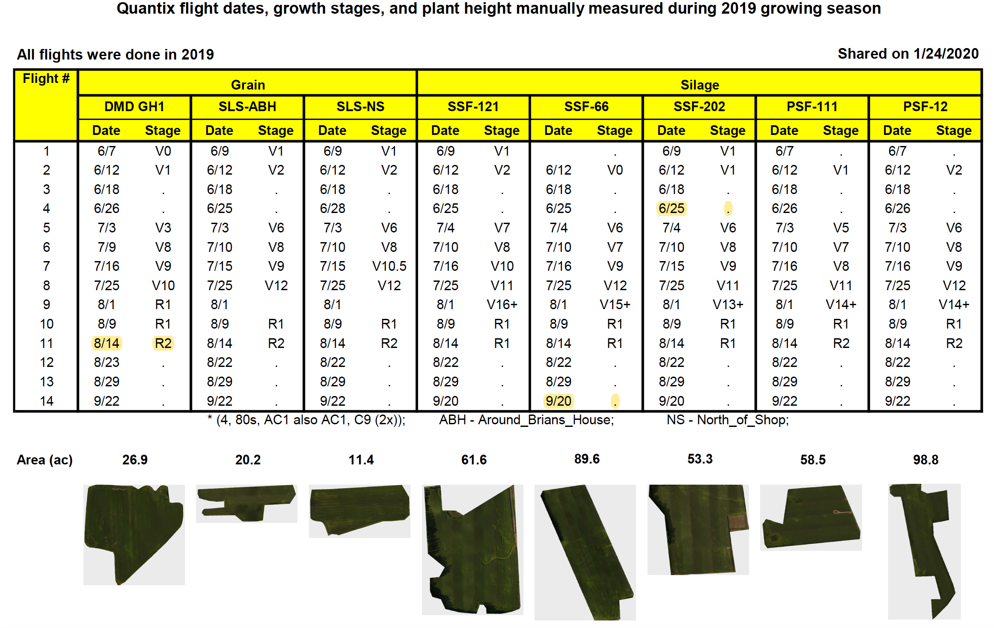

Slide 2
DMD_GH1

Slide 3
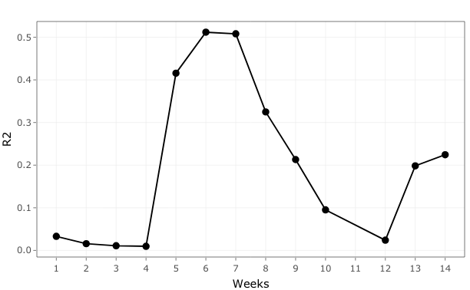

Slide 4
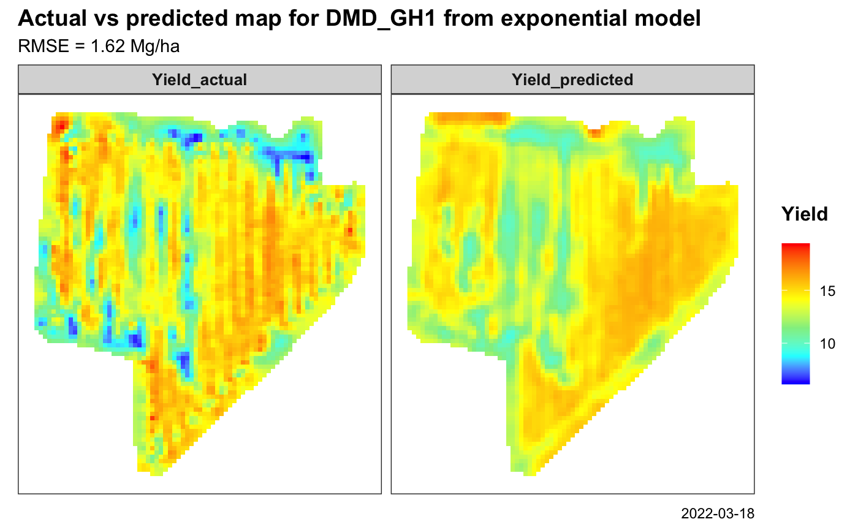

Slide 5
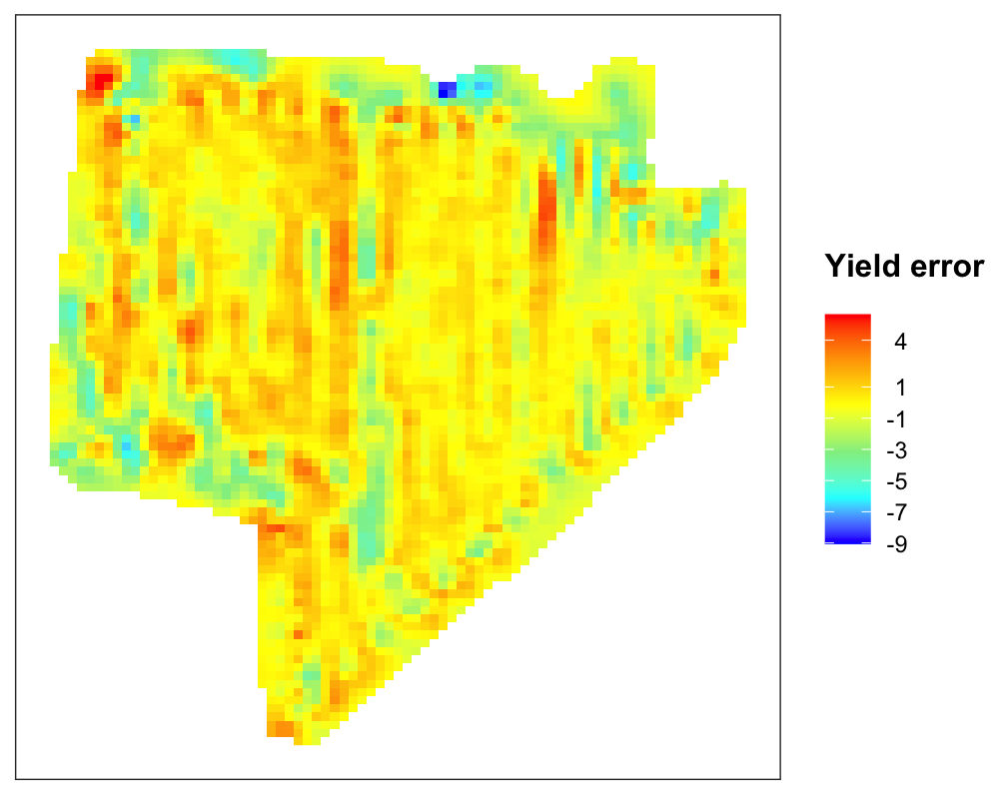
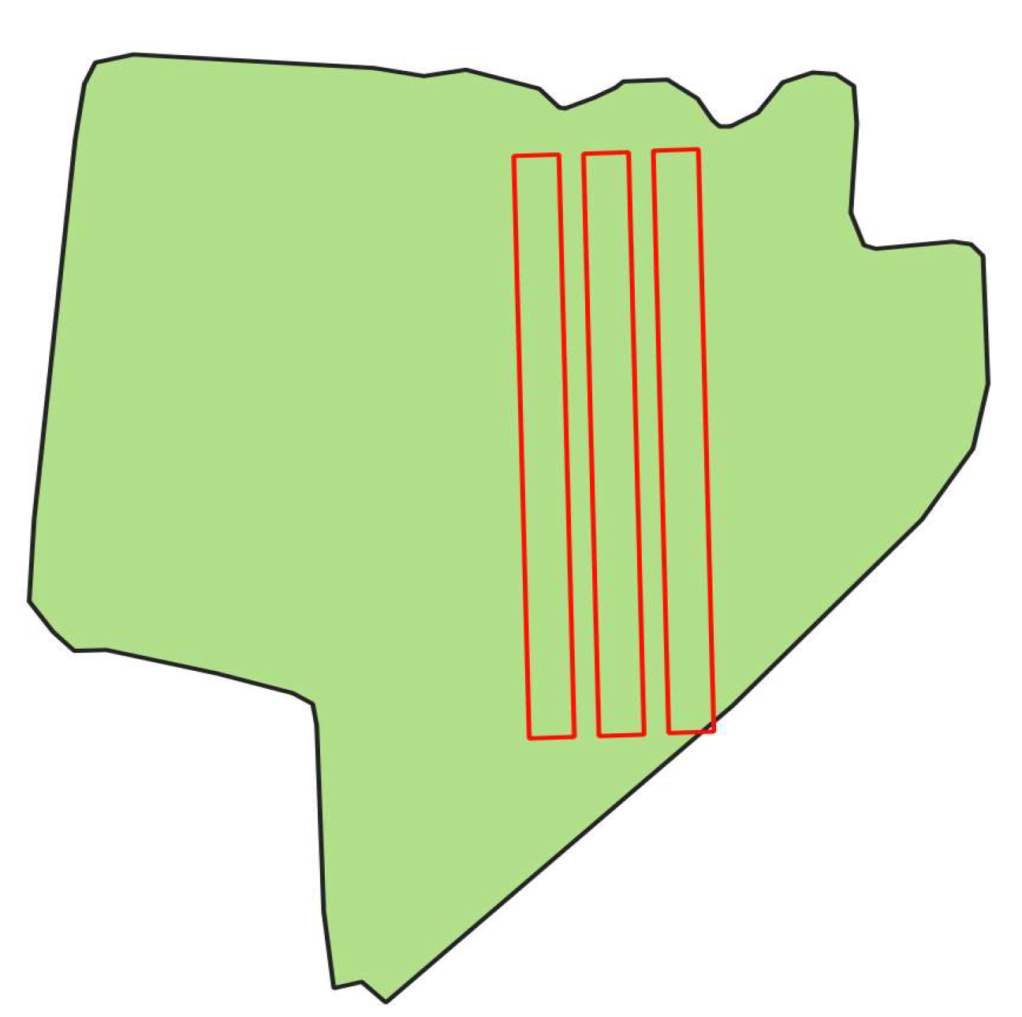

Slide 6
SSF_121

Slide 7
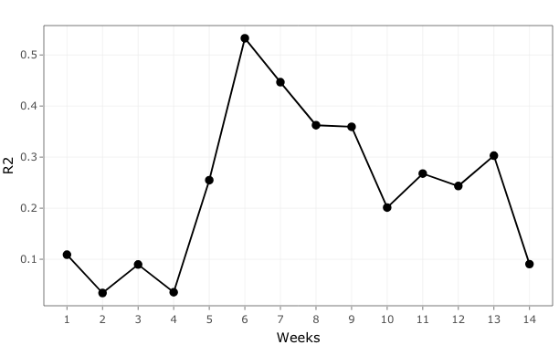

Slide 8
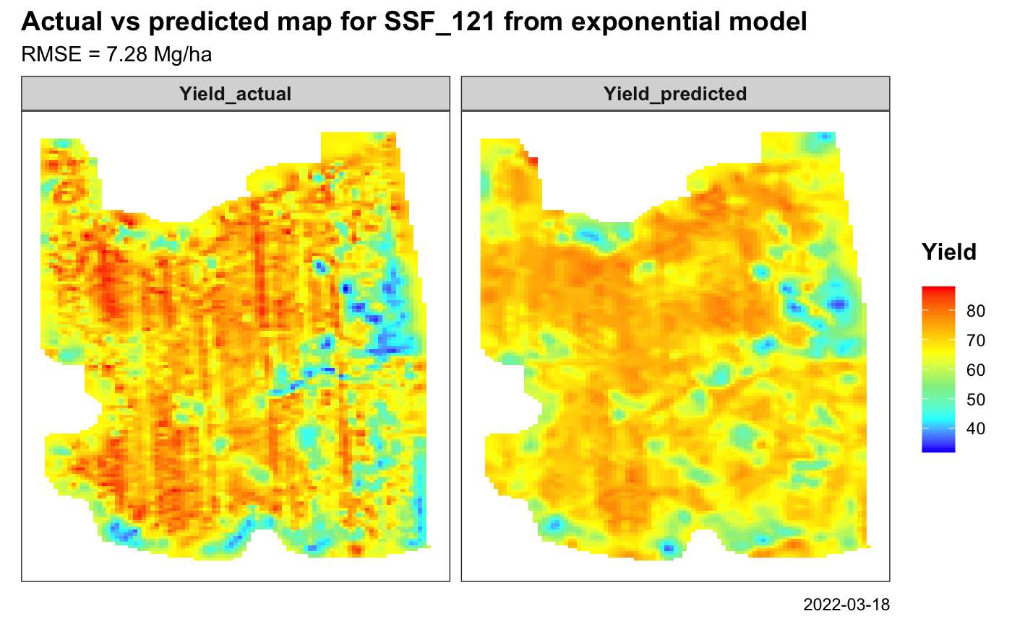

Slide 9
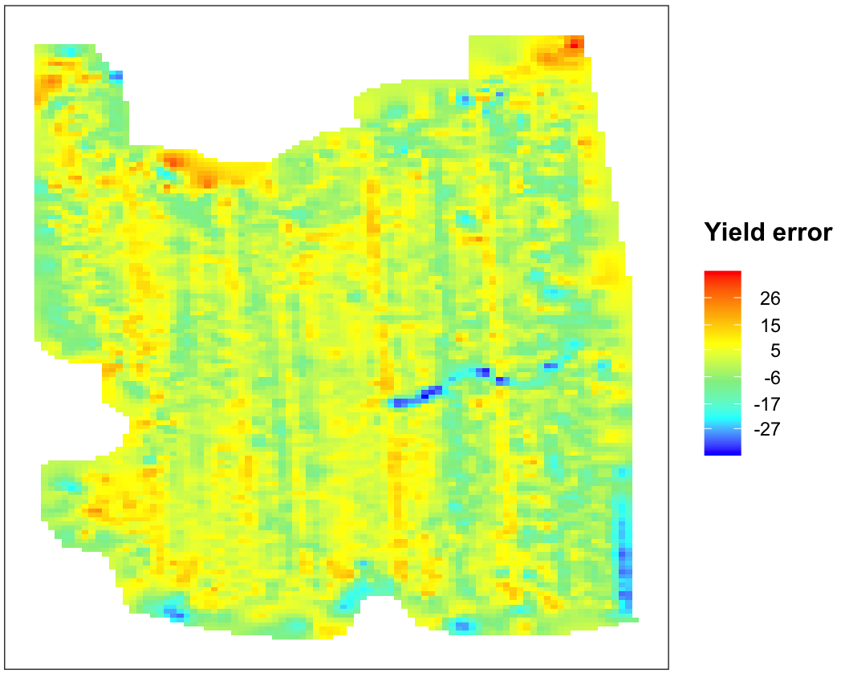
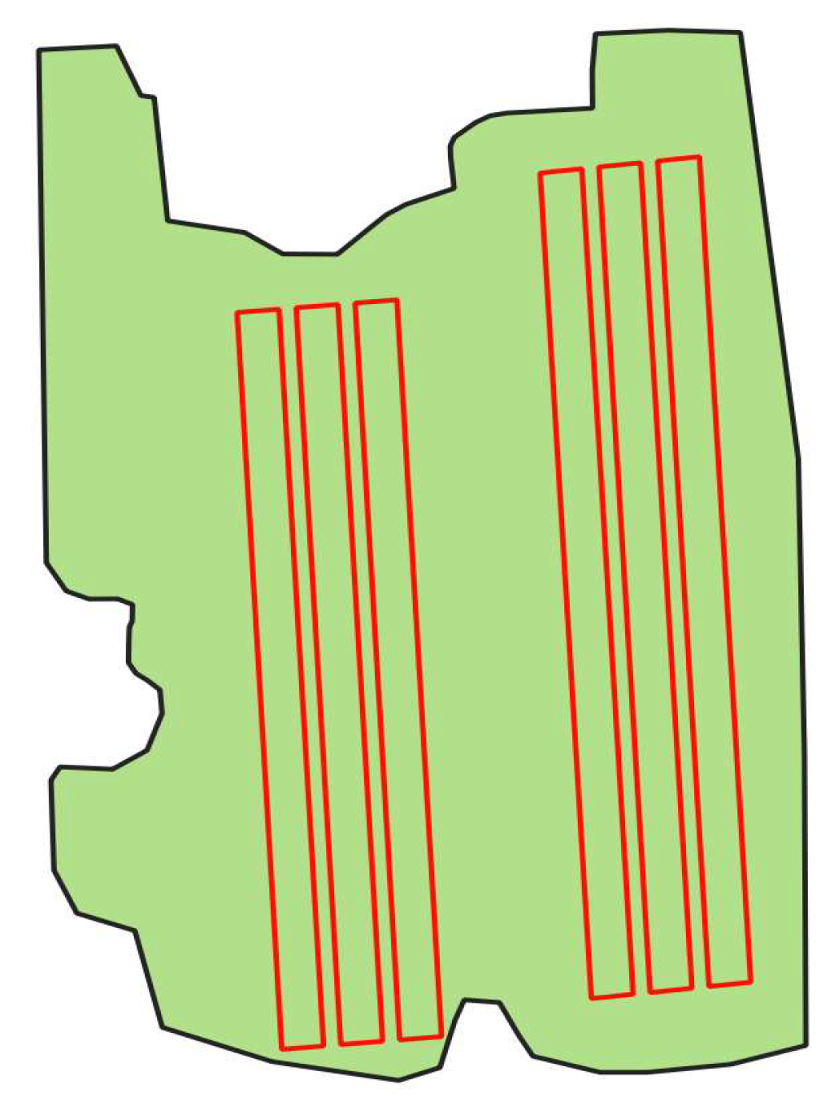

Slide 10
PSF_12

Slide 11
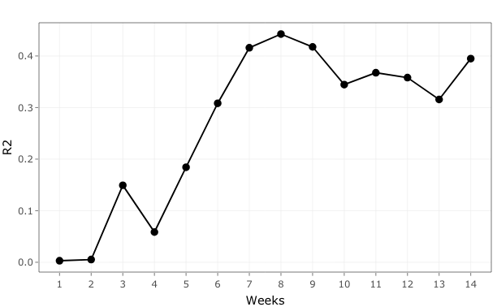

Slide 12
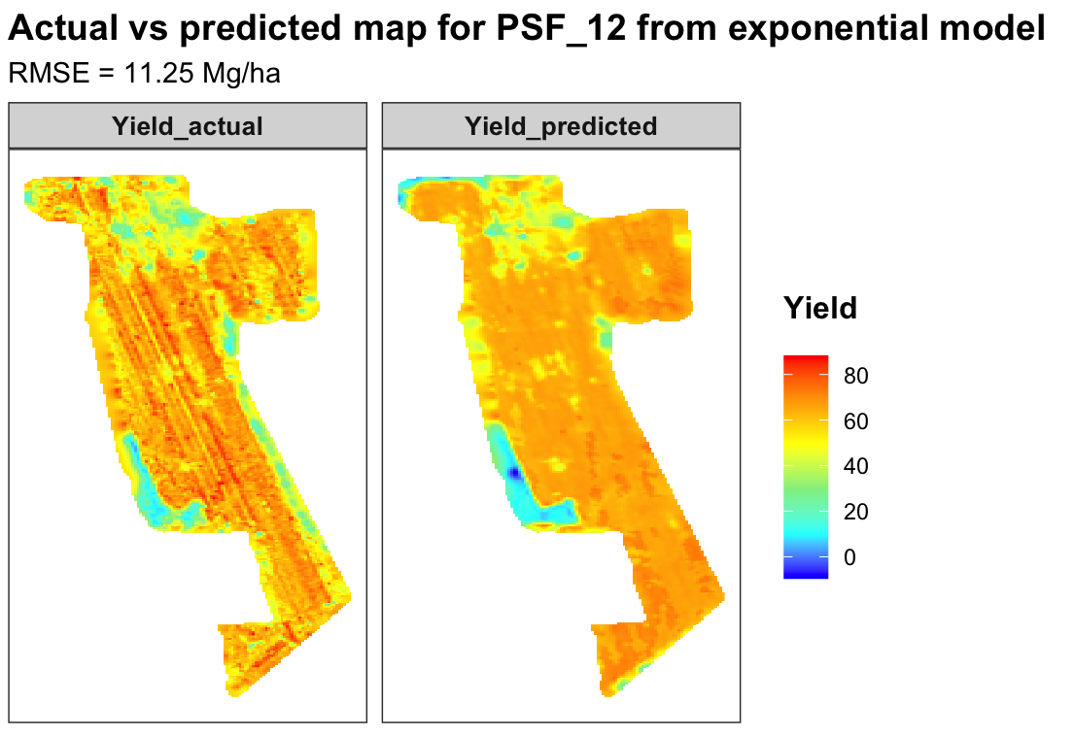

Slide 13
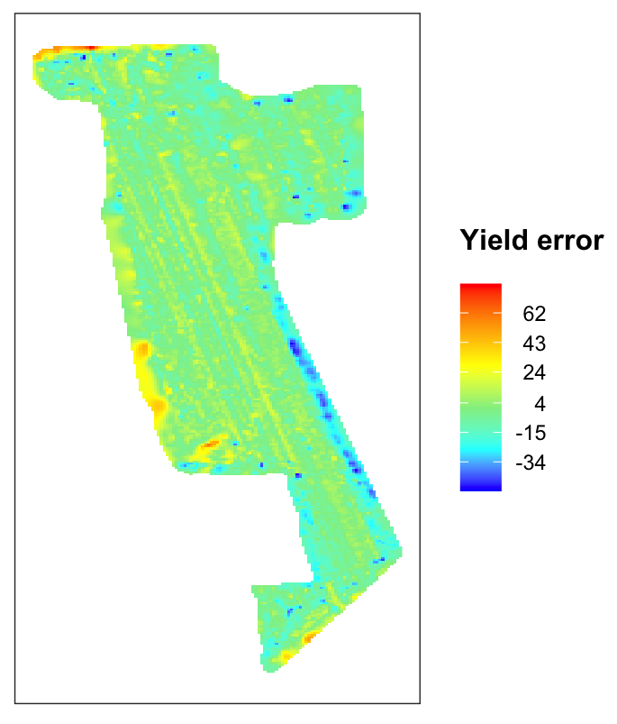
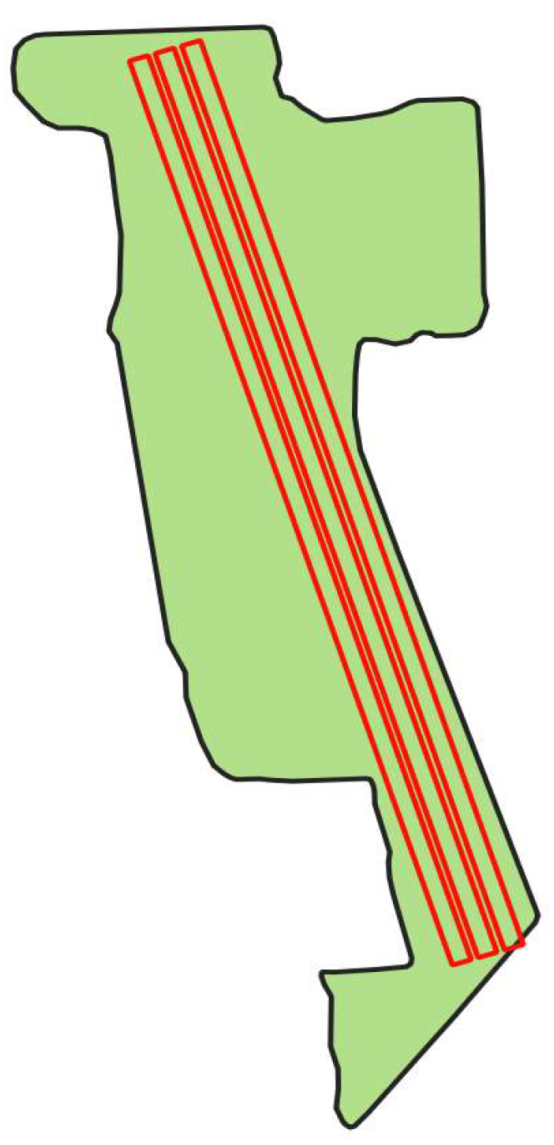

Slide 14
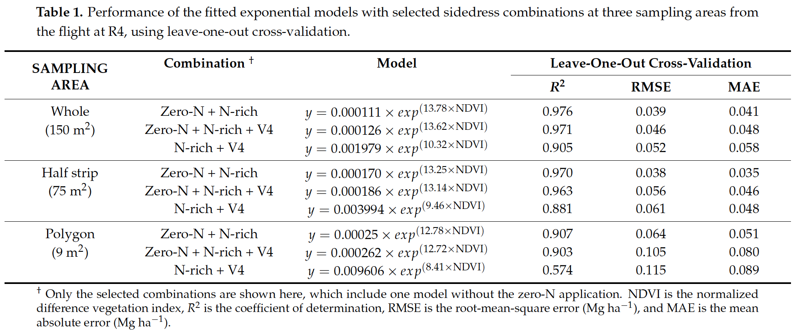
So far, we have just replicated/scaled our E3 work to commercial fields.

Slide 15
Future steps:
Do we need those strips? 80:20? Reasonable prediction without strip? Reference strip upfront - Nrich and sidedress. Yield prediction – N application upfront.
Select only NA values from N column and use that for exp model.
Select upper and lower 10% of the data and build model. – Almost replicating the NoN and Nrich treatments.
Other fields are crazy with R² and error – Troubleshoot and verify those maps
Some exploratory data analysis – visualizations and correlation
Leave one field out and test the left out field
Try all other vegetation indices – individually.
Yield = f(NDVI, EXG, EVI2…) → each week
NDVI = f(weather) → for whole season

Slide 16
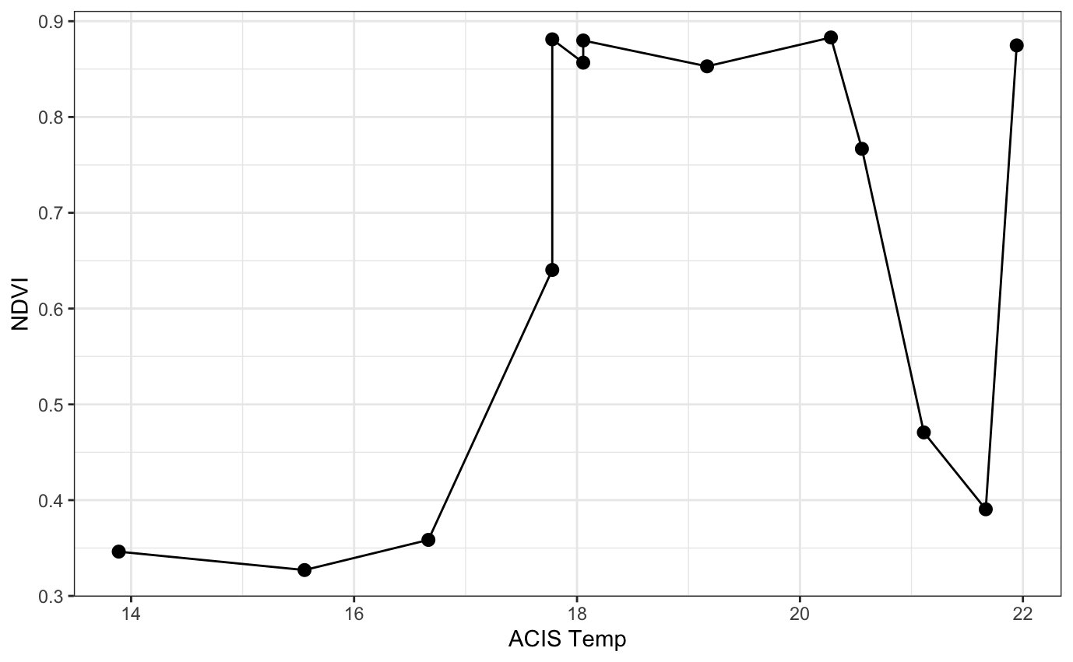
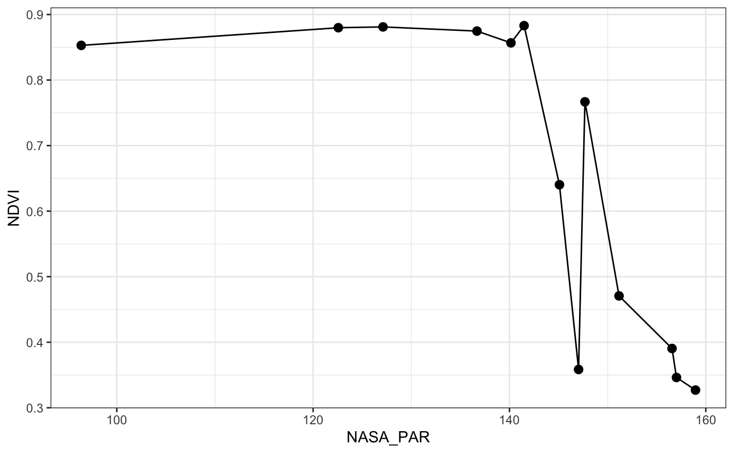

Slide 17
Yield
NDVI

Slide 18
Do we need to have N strips for accurate yield estimation?

Slide 19
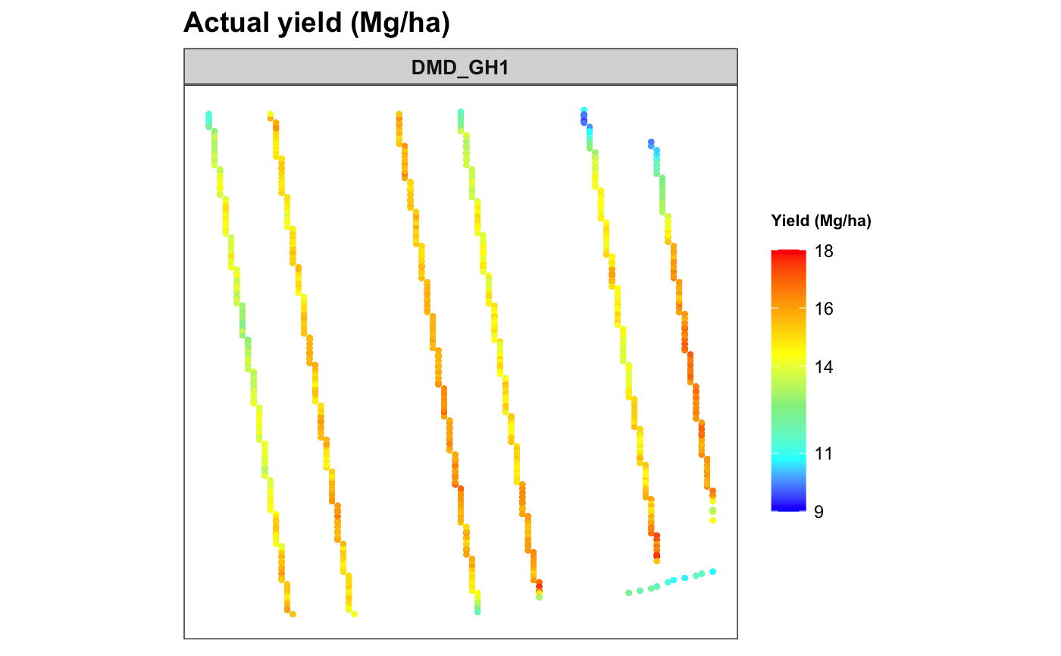
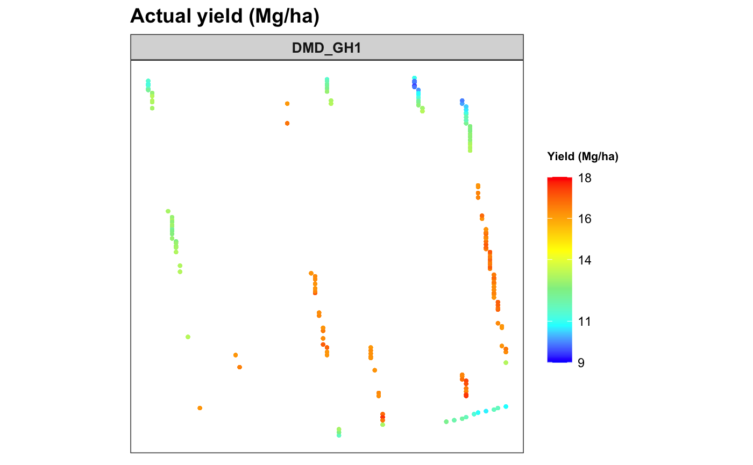
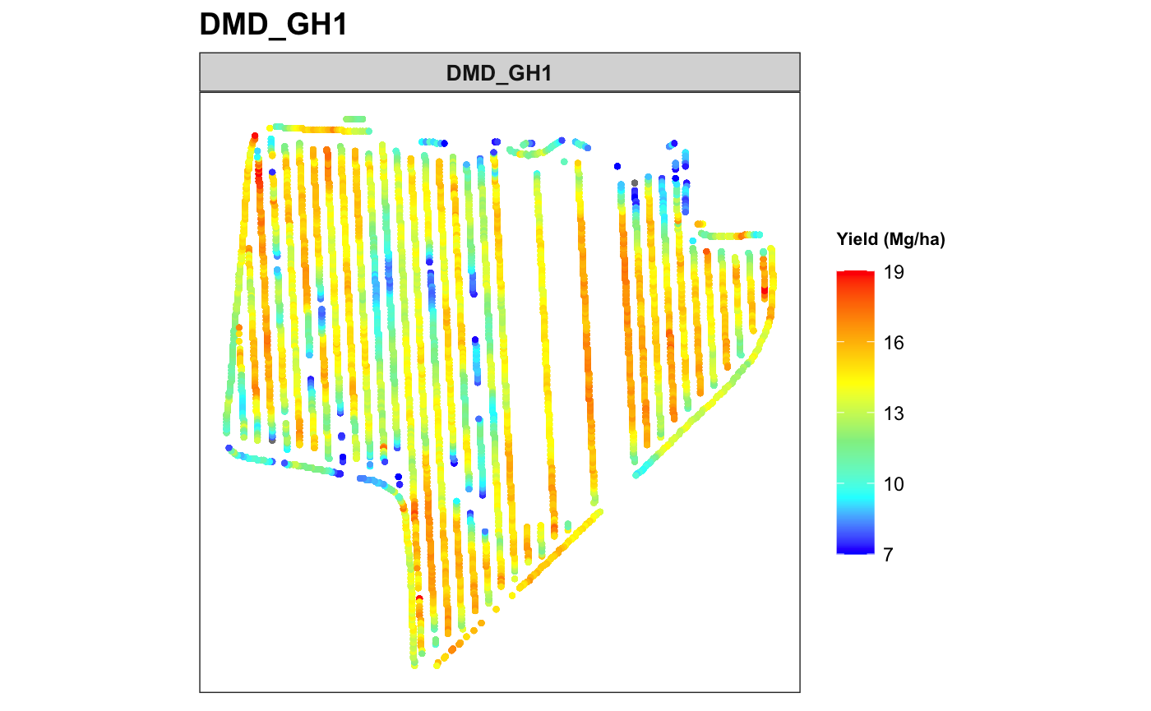
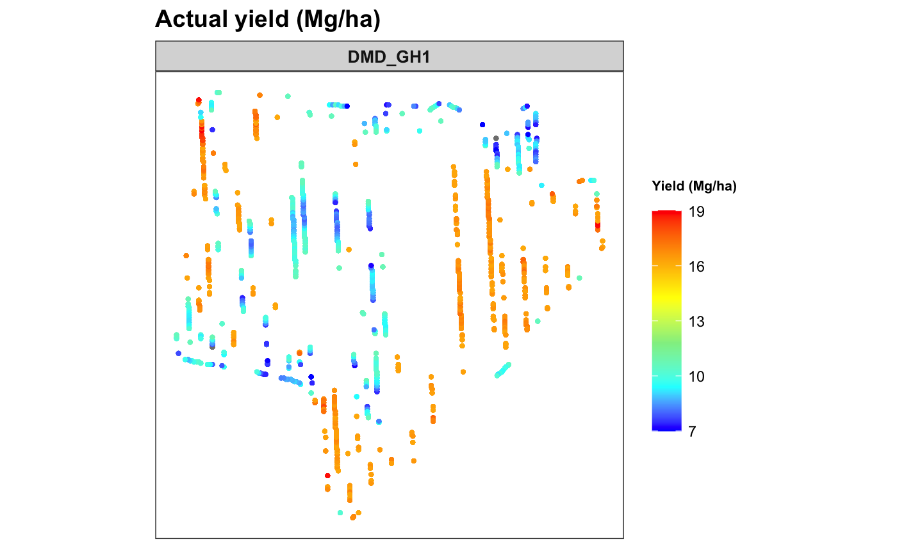
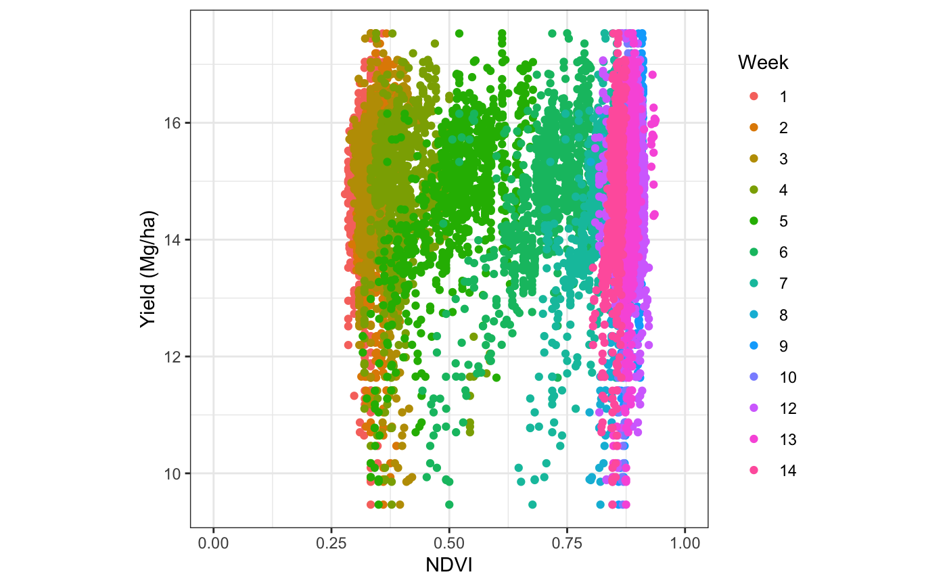
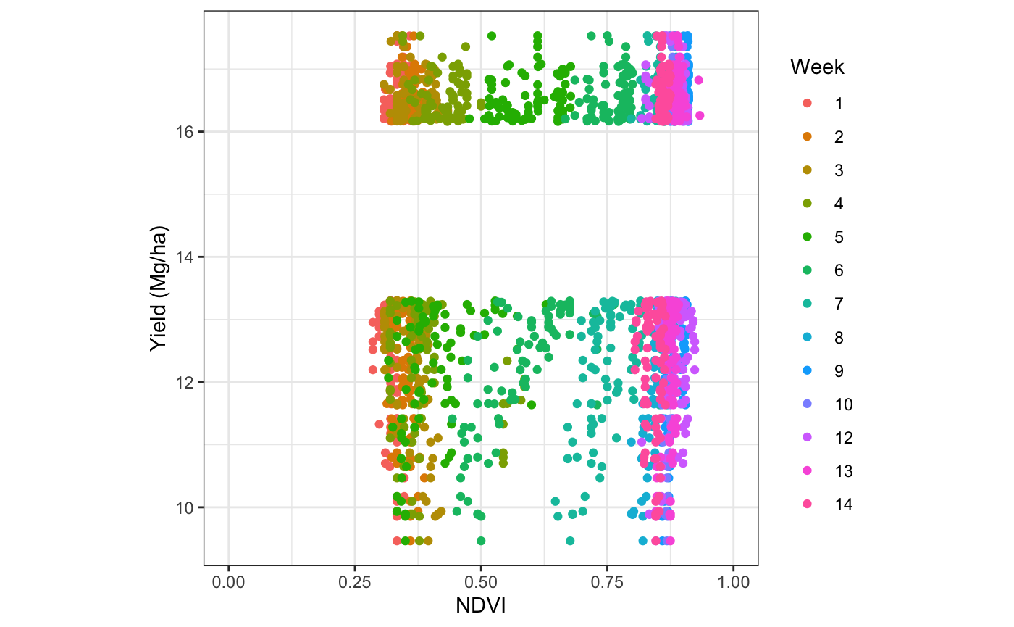
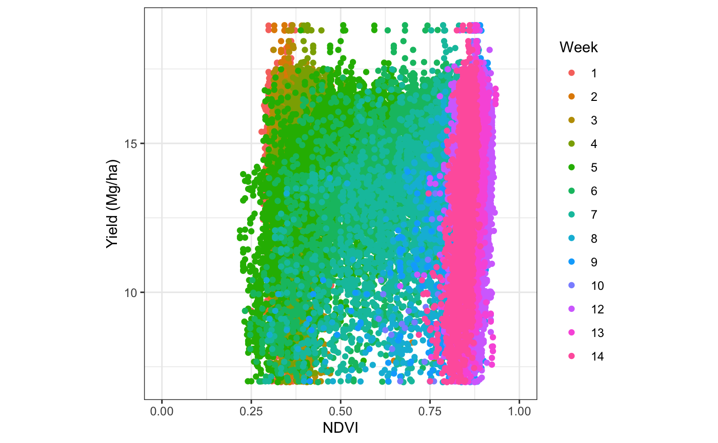
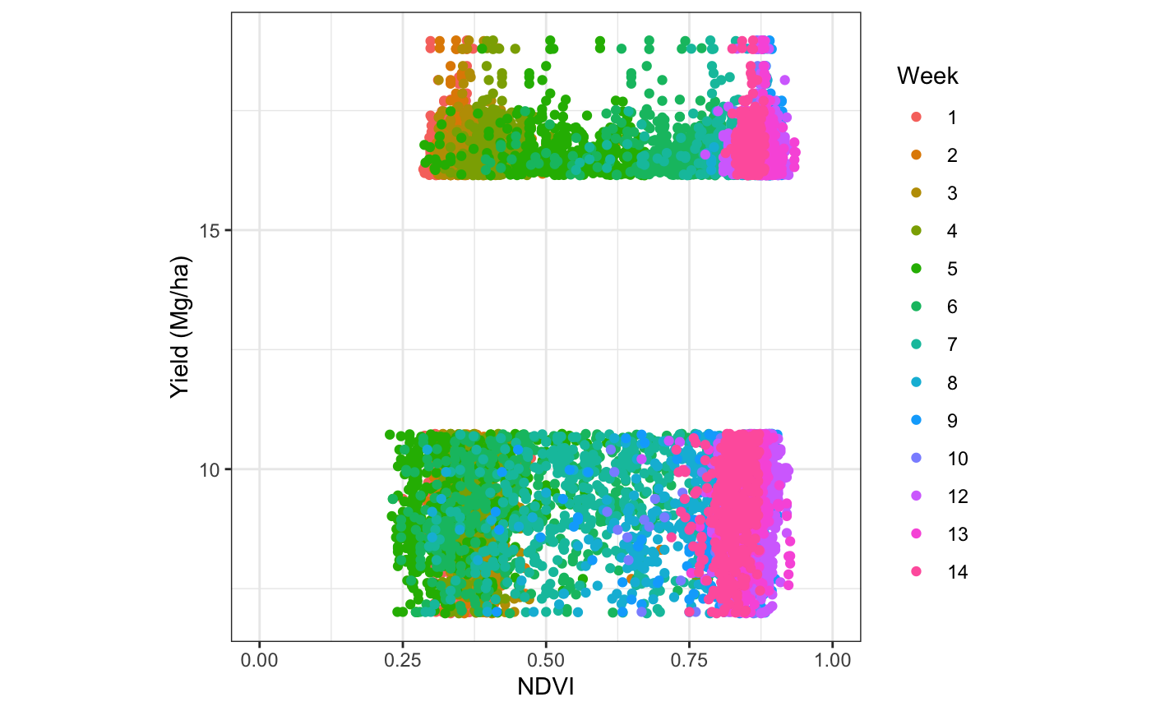
Approach 1
Approach 2
A
B
A
B

Slide 20
Show R markdown results

Slide 21
Table #. Coefficient of determination values from exponential models developed for grain fields from weekly flights with four different approaches
Weeks | DMD_GH1 |  |  |  |  | SLS_ABH |  |  |  |  | SLS_NS
Weeks | 1a | 1b | 2a | 2b |  | 1a | 1b | 2a | 2b |  | 1a | 1b | 2a | 2b
1 | 0.033 | 0.200 | 0.004 | 0.005 |  | 0.001 | 0.002 | 0.001 | 0.016 |  | 0.195 | 0.302 | 0.043 | 0.109
2 | 0.016 | 0.070 | 0.017 | 0.039 |  | 0.000 | 0.000 | 0.014 | 0.001 |  | 0.015 | 0.007 | 0.001 | 0.000
3 | 0.011 | 0.002 | 0.007 | 0.019 |  | 0.083 | 0.176 | 0.137 | 0.244 |  | 0.016 | 0.050 | 0.030 | 0.051
4 | 0.010 | 0.068 | 0.074 | 0.254 |  | 0.005 | 0.007 | 0.001 | 0.025 |  | 0.030 | 0.021 | 0.013 | 0.016
5 | 0.416 | 0.706 | 0.280 | 0.548 |  | 0.080 | 0.283 | 0.274 | 0.556 |  | 0.138 | 0.151 | 0.138 | 0.250
6 | 0.512 | 0.828 | 0.389 | 0.617 |  | 0.171 | 0.436 | 0.315 | 0.535 |  | 0.372 | 0.581 | 0.183 | 0.333
7 | 0.508 | 0.755 | 0.392 | 0.569 |  | 0.247 | 0.469 | 0.445 | 0.650 |  | 0.383 | 0.510 | 0.218 | 0.418
8 | 0.325 | 0.719 | 0.339 | 0.395 |  | 0.104 | 0.224 | 0.413 | 0.497 |  | 0.263 | 0.321 | 0.183 | 0.272
9 | 0.213 | 0.434 | 0.262 | 0.283 |  | 0.006 | 0.014 | 0.270 | 0.389 |  | 0.112 | 0.152 | 0.090 | 0.162
10 | 0.095 | 0.360 | 0.232 | 0.237 |  | 0.075 | 0.224 | 0.266 | 0.370 |  | 0.089 | 0.112 | 0.037 | 0.066
11 |  |  |  |  |  | 0.002 | 0.017 | 0.156 | 0.256 |  | 0.122 | 0.185 | 0.031 | 0.039
12 | 0.024 | 0.054 | 0.021 | 0.032 |  | 0.049 | 0.118 | 0.258 | 0.382 |  | 0.324 | 0.376 | 0.168 | 0.243
13 | 0.198 | 0.427 | 0.387 | 0.471 |  | 0.058 | 0.154 | 0.186 | 0.291 |  | 0.199 | 0.314 | 0.116 | 0.230
14 | 0.224 | 0.302 | 0.284 | 0.388 |  | 0.026 | 0.036 | 0.064 | 0.140 |  | 0.149 | 0.130 | 0.113 | 0.226
1a – Only strips data – similar to E3 paper
1b – Only strip data – but lower and upper 10% of data
2a – Whole field data without N strip
2b – Whole field data without N strip - but lower and upper 10% of data

Slide 22
Table #. Coefficient of determination values from exponential models developed for silage fields from weekly flights with four different approaches
Weeks | SSF_121 | SSF_121 |  |  |  | SSF_66 |  |  |  |  | SSF_202 |  |  |  |  | PSF_111 |  |  |  |  | PSF_12
Weeks | 1a | 1b | 2a | 2b |  | 1a | 1b | 2a | 2b |  | 1a | 1b | 2a | 2b |  | 1a | 1b | 2a | 2b |  | 1a | 1b | 2a | 2b
1 | 0.077 | 0.158 | 0.144 | 0.177 |  | 0.001 | 0.011 | 0.054 | 0.105 |  | 0.052 | 0.057 | 0.042 | 0.080 |  | 0.002 | 0.006 | 0.071 | 0.062 |  | 0.003 | 0.017 | 0.087 | 0.171
2 | 0.051 | 0.115 | 0.135 | 0.172 |  | 0.001 | 0.002 | 0.023 | 0.089 |  | 0.046 | 0.051 | 0.043 | 0.081 |  | 0.011 | 0.050 | 0.082 | 0.071 |  | 0.005 | 0.016 | 0.059 | 0.103
3 | 0.171 | 0.253 | 0.262 | 0.336 |  | 0.006 | 0.022 | 0.039 | 0.087 |  |  |  |  |  |  | 0.000 | 0.005 | 0.104 | 0.093 |  | 0.149 | 0.288 | 0.189 | 0.255
4 | 0.060 | 0.088 | 0.136 | 0.185 |  | 0.002 | 0.008 | 0.007 | 0.050 |  | 0.012 | 0.024 | 0.028 | 0.081 |  | 0.008 | 0.028 | 0.041 | 0.045 |  | 0.059 | 0.141 | 0.074 | 0.091
5 | 0.382 | 0.553 | 0.110 | 0.146 |  | 0.015 | 0.024 | 0.083 | 0.178 |  | 0.002 | 0.001 | 0.001 | 0.001 |  | 0.062 | 0.140 | 0.097 | 0.228 |  | 0.184 | 0.351 | 0.157 | 0.346
6 | 0.555 | 0.709 | 0.368 | 0.492 |  | 0.024 | 0.056 | 0.086 | 0.154 |  | 0.056 | 0.079 | 0.025 | 0.079 |  | 0.054 | 0.105 | 0.206 | 0.362 |  | 0.308 | 0.457 | 0.388 | 0.578
7 | 0.512 | 0.637 | 0.383 | 0.495 |  | 0.012 | 0.050 | 0.070 | 0.127 |  | 0.100 | 0.144 | 0.065 | 0.128 |  | 0.086 | 0.146 | 0.243 | 0.411 |  | 0.416 | 0.518 | 0.553 | 0.687
8 | 0.412 | 0.467 | 0.254 | 0.313 |  | 0.032 | 0.078 | 0.091 | 0.142 |  | 0.048 | 0.075 | 0.020 | 0.047 |  | 0.040 | 0.054 | 0.230 | 0.331 |  | 0.442 | 0.490 | 0.583 | 0.622
9 | 0.445 | 0.565 | 0.296 | 0.427 |  | 0.023 | 0.058 | 0.085 | 0.127 |  | 0.079 | 0.114 | 0.071 | 0.158 |  | 0.043 | 0.120 | 0.237 | 0.334 |  | 0.418 | 0.469 | 0.591 | 0.605
10 | 0.243 | 0.316 | 0.204 | 0.286 |  | 0.017 | 0.050 | 0.073 | 0.113 |  | 0.057 | 0.102 | 0.017 | 0.048 |  | 0.020 | 0.046 | 0.104 | 0.193 |  | 0.344 | 0.407 | 0.573 | 0.596
11 | 0.343 | 0.484 | 0.161 | 0.278 |  | 0.040 | 0.090 | 0.079 | 0.141 |  | 0.029 | 0.045 | 0.004 | 0.005 |  | 0.024 | 0.045 | 0.183 | 0.230 |  | 0.368 | 0.425 | 0.585 | 0.592
12 | 0.361 | 0.514 | 0.231 | 0.345 |  | 0.026 | 0.075 | 0.072 | 0.153 |  | 0.118 | 0.186 | 0.076 | 0.167 |  | 0.044 | 0.093 | 0.099 | 0.141 |  | 0.358 | 0.423 | 0.548 | 0.570
13 | 0.378 | 0.548 | 0.255 | 0.356 |  | 0.033 | 0.079 | 0.060 | 0.113 |  | 0.124 | 0.214 | 0.035 | 0.094 |  | 0.042 | 0.087 | 0.158 | 0.194 |  | 0.316 | 0.378 | 0.532 | 0.581
14 | 0.176 | 0.330 | 0.076 | 0.134 |  |  |  |  |  |  | 0.072 | 0.125 | 0.014 | 0.024 |  | 0.060 | 0.096 | 0.079 | 0.095 |  | 0.395 | 0.441 | 0.432 | 0.523
1a – Only strips data – similar to E3 paper
1b – Only strip data – but lower and upper 10% of data
2a – Whole field data without N strip
2b – Whole field data without N strip - but lower and upper 10% of data

Slide 23
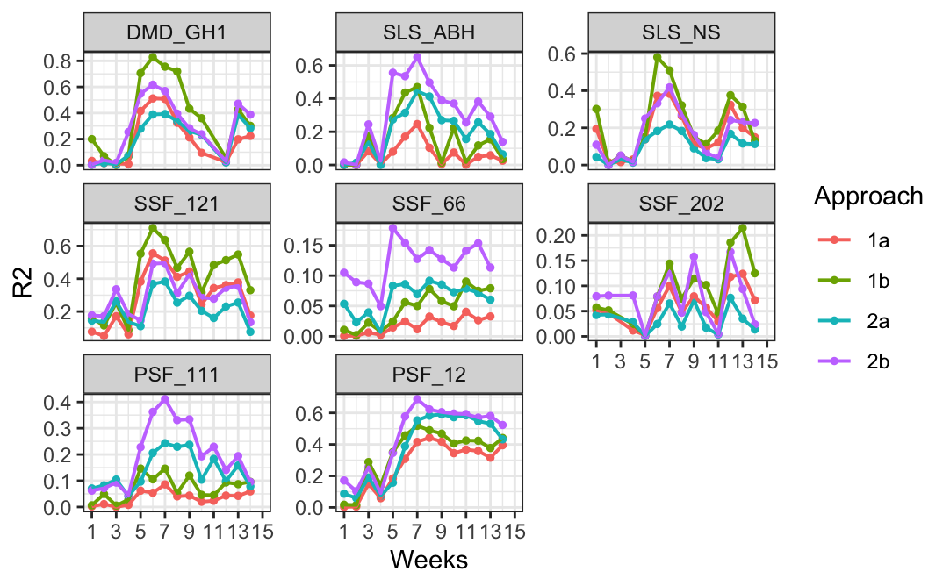

Slide 24
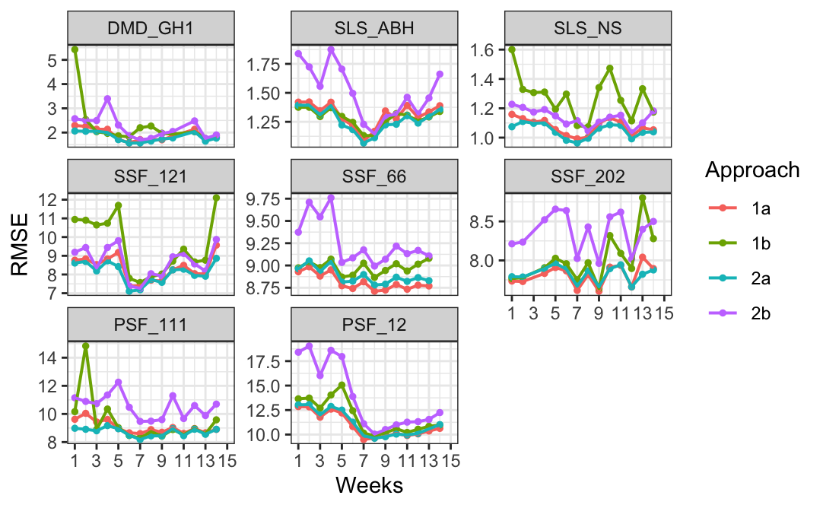

Slide 25
Future steps:
Do we need those strips? 80:20? Reasonable prediction without strip? Reference strip upfront - Nrich and sidedress. Yield prediction – N application upfront.
Select only NA values from N column and use that for exp model.
Select upper and lower 10% of the data and build model. – Almost replicating the NoN and Nrich treatments.
Other fields are crazy with R² and error – Troubleshoot and verify those maps
Some exploratory data analysis – visualizations and correlation
Leave one field out and test the left out field
Try all other vegetation indices – individually.
Yield = f(NDVI, EXG, EVI2…) → each week
NDVI = f(weather) → for whole season
How much percentile? – variable

Slide 26
Q2 -

